Slide 1
Malignant comment classification project
Submitted by
Akash

Slide 2
Table of contents
Data summery
Data cleaning
Data visualization
Data preprocessing
Train the model
Saving the model

Slide 3
Data summery
The proliferation of social media enables people to express their opinions widely online. However, at the same time, this has resulted in the emergence of conflict and hate, making online environments uninviting for users. Although researchers have found that hate is a problem across multiple platforms, there is a lack of models for online hate detection. Online hate, described as abusive language, aggression, cyberbullying, hatefulness and many others has been identified as a major threat on online social media platforms. Social media platforms are the most prominent grounds for such toxic behaviour. There has been a remarkable increase in the cases of cyberbullying and trolls on various social media platforms. Many celebrities and influences are facing backlashes from people and have to come across hateful and offensive comments. This can take a toll on anyone and affect them mentally leading to depression, mental illness, self-hatred and suicidal thoughts. Internet comments are bastions of hatred and vitriol. While online anonymity has provided a new outlet for aggression and hate speech, machine learning can be used to fight it. The problem we sought to solve was the tagging of internet comments that are aggressive towards other users. This means that insults to third parties such as celebrities will be tagged as unoffensive, but “u are an idiot” is clearly offensive. Our goal is to build a prototype of online hate and abuse comment classifier which can used to classify hate and offensive comments so that it can be controlled and restricted from spreading hatred and cyberbullying. Data Set Description The data set contains the training set, which has approximately 1,59,000 samples and the test set which contains nearly 1,53,000 samples. All the data samples contain 8 fields which includes ‘Id’, ‘Comments’, ‘Malignant’, ‘Highly malignant’, ‘Rude’, ‘Threat’, ‘Abuse’ and ‘Loathe’. The label can be either 0 or 1, where 0 denotes a NO while 1 denotes a YES. There are various comments which have multiple labels. The first attribute is a unique ID associated with each comment. The data set includes:

Slide 4
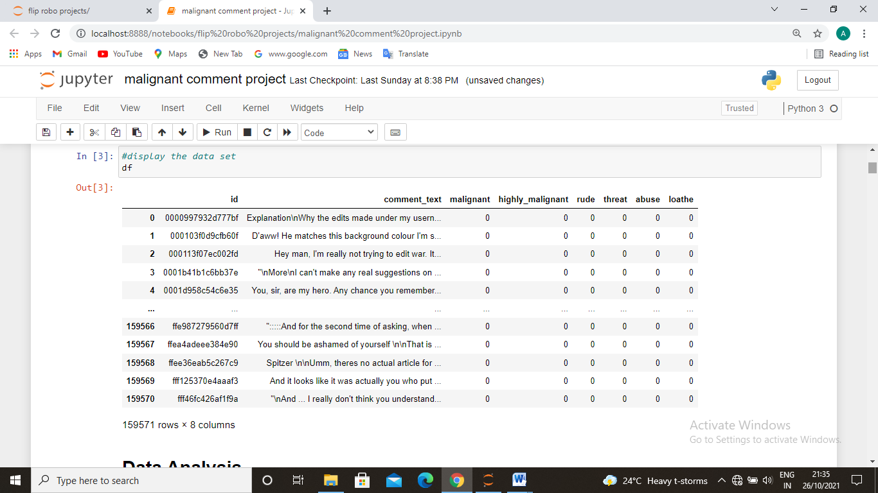
Data cleaning
The data is gathered from celebrities page. The project was assigned to me by mr.keshav bansal data scientist and sme.
The data used for making machine learning model to classify the bad comments and their categories.

Slide 5
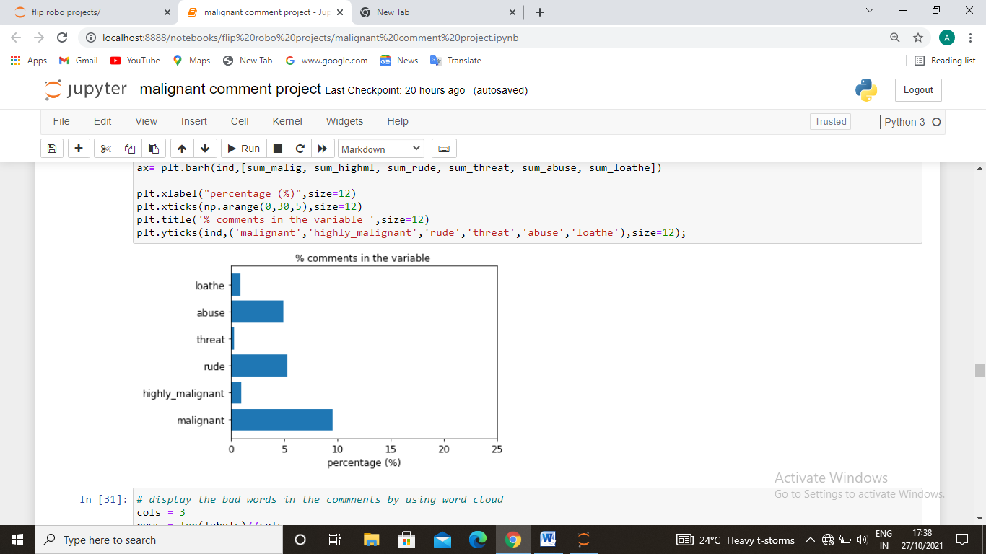
Data preprocessing
First of all we got data the data in csv file form so we import this into our workbook. we need to clean up the data although its almost cleaned because we get the sorted data so we just added only those columns which we need the most so first we need to clean the data in the data there are 159000 rows and 8 columns. So first we check the null values in the columns so we have distribute the bad and normal comments in different parts and we got 89.83% normal comments and 10.17% bad comments. So we have check the data distribution of the bad comments and their categories Than we correlate the targeted variable with some important independent variables. For data cleaning we lower all the comments and remove some artificial words or numbers like nan, /n, umm etc. by using nltk than we make the word cloud to find the bad words and classify accourdingly.

Slide 6
Data Inputs- Logic- Output Relationships
The data set includes:
Malignant: It is the Label column, which includes values 0 and 1, denoting if the comment is malignant or not.
Highly Malignant: It denotes comments that are highly malignant and hurtful.
Rude: It denotes comments that are very rude and offensive.
Threat: It contains indication of the comments that are giving any threat to someone.
Abuse: It is for comments that are abusive in nature.
Loathe: It describes the comments which are hateful and loathing in nature.
ID: It includes unique Ids associated with each comment text given.
Comment text: This column contains the comments extracted from various social media platforms.

Slide 7
Testing of Identified Approaches (Algorithms)
Algorithms which are used for training and testing are:
Logistic regression
Ada boost regressor
Decision tree classifier
Random forest classifier.

Slide 8
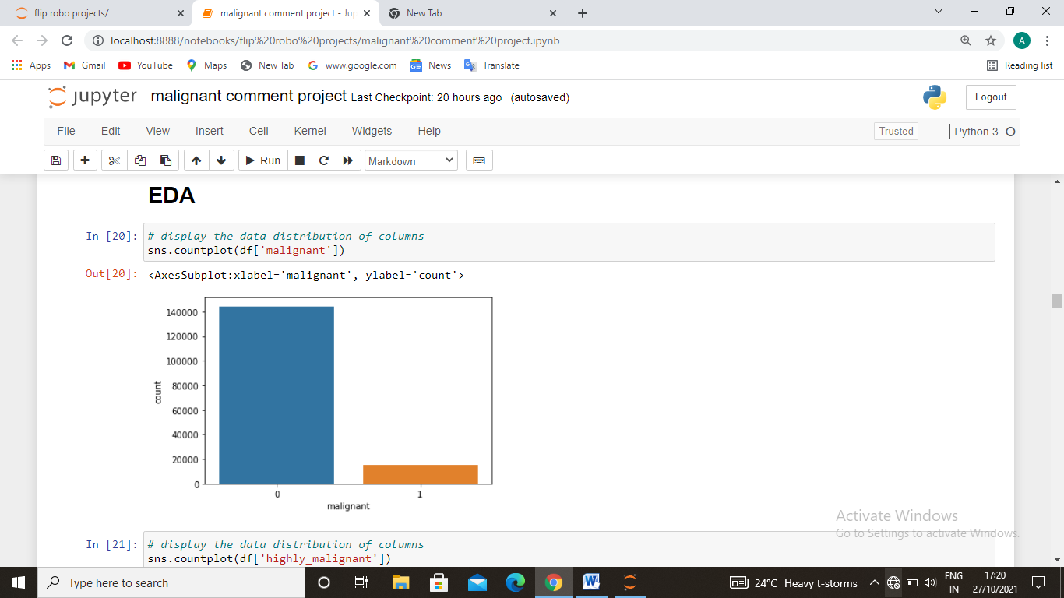
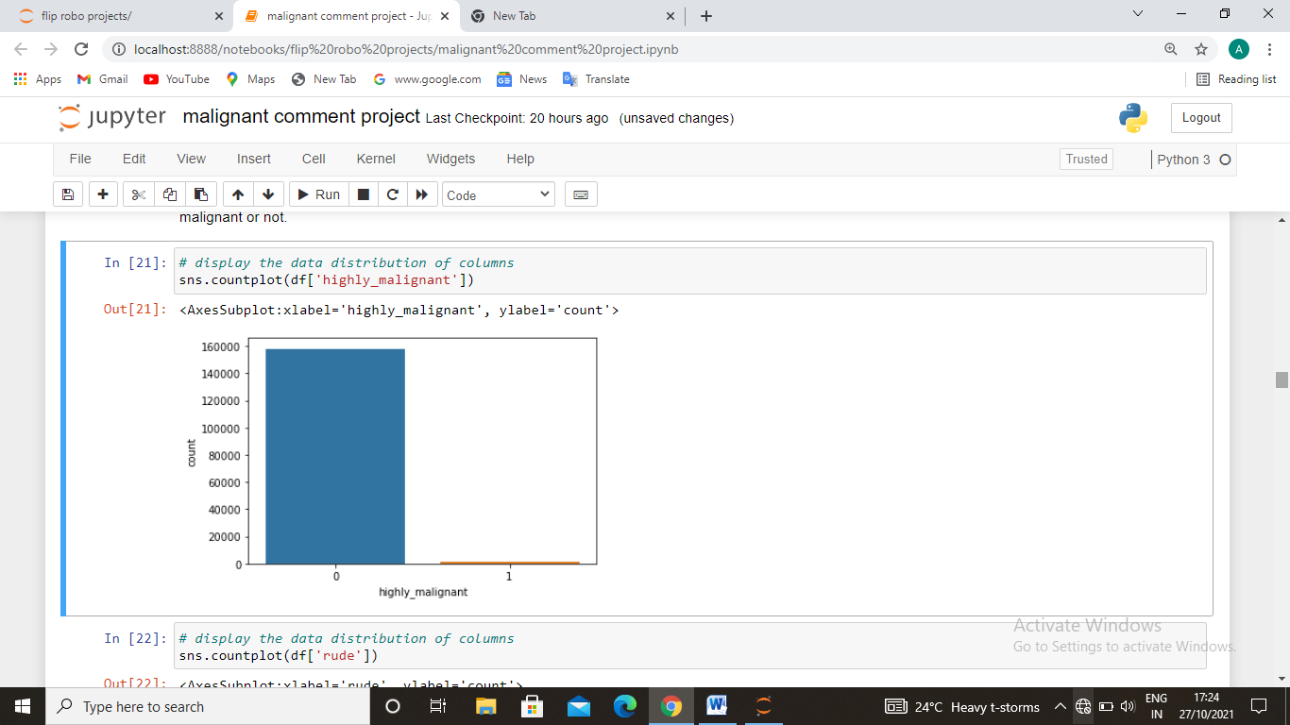
visualization
1. checking the data distribution of malignant and highly malignant.
Observation- The number of malignant comments are very low as compare to normal comments. Here the blue bar represents no and 1 represents yes that tha comment is malignant and highly malignant or not.

Slide 9
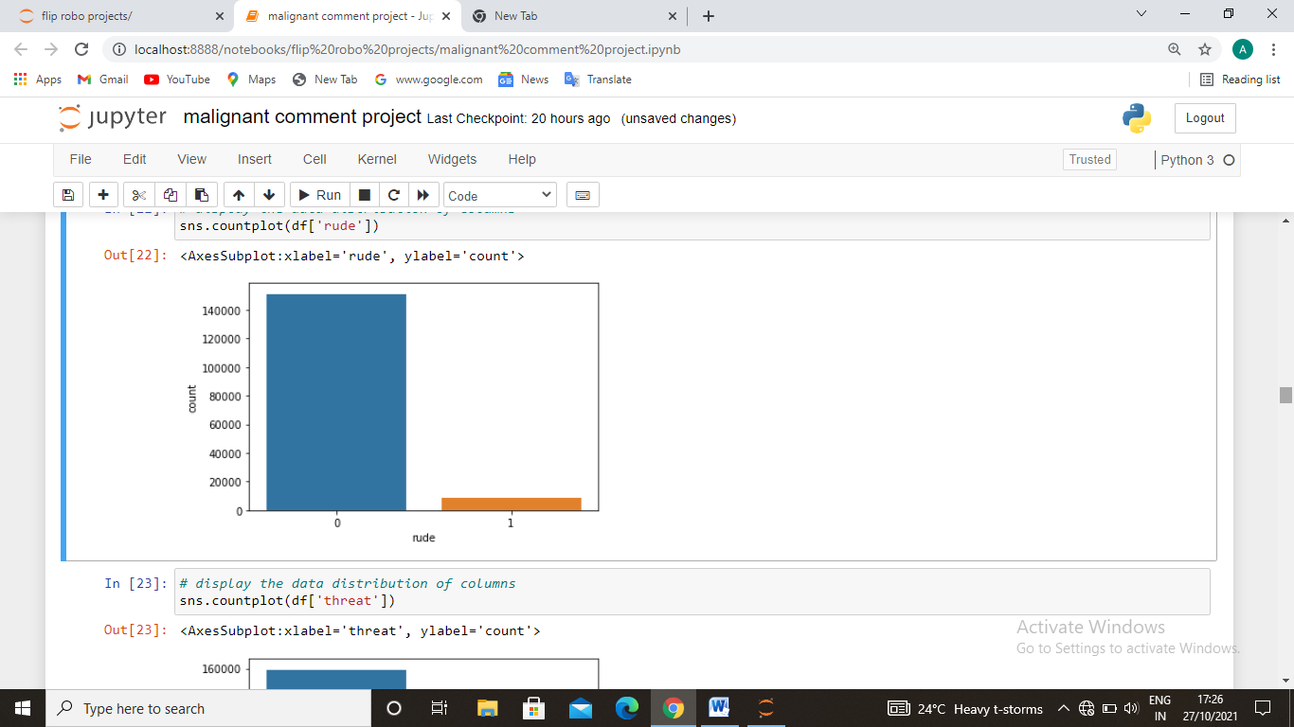
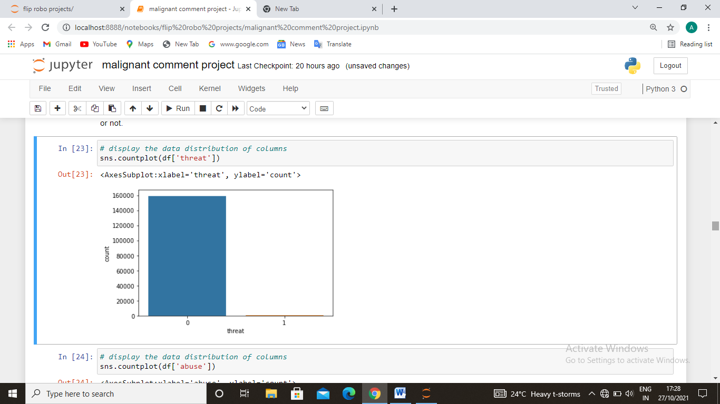
Checking data distribution of rude and threat category coments
Observation - The number of threat comments are very low as compare to normal comments. Here the blue bar represents no and 1 represents yes that the comment is threat and rude or not.

Slide 10
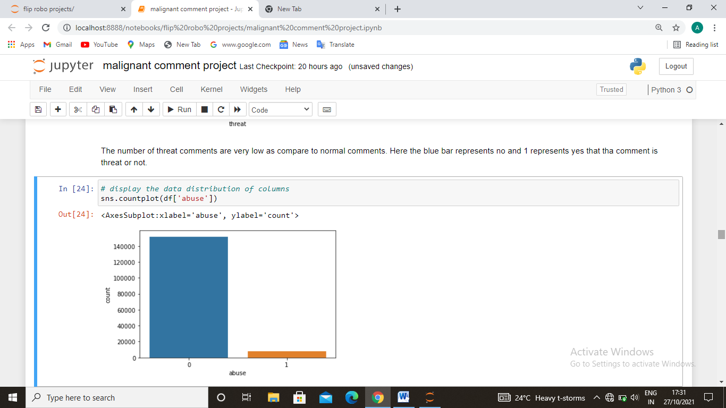
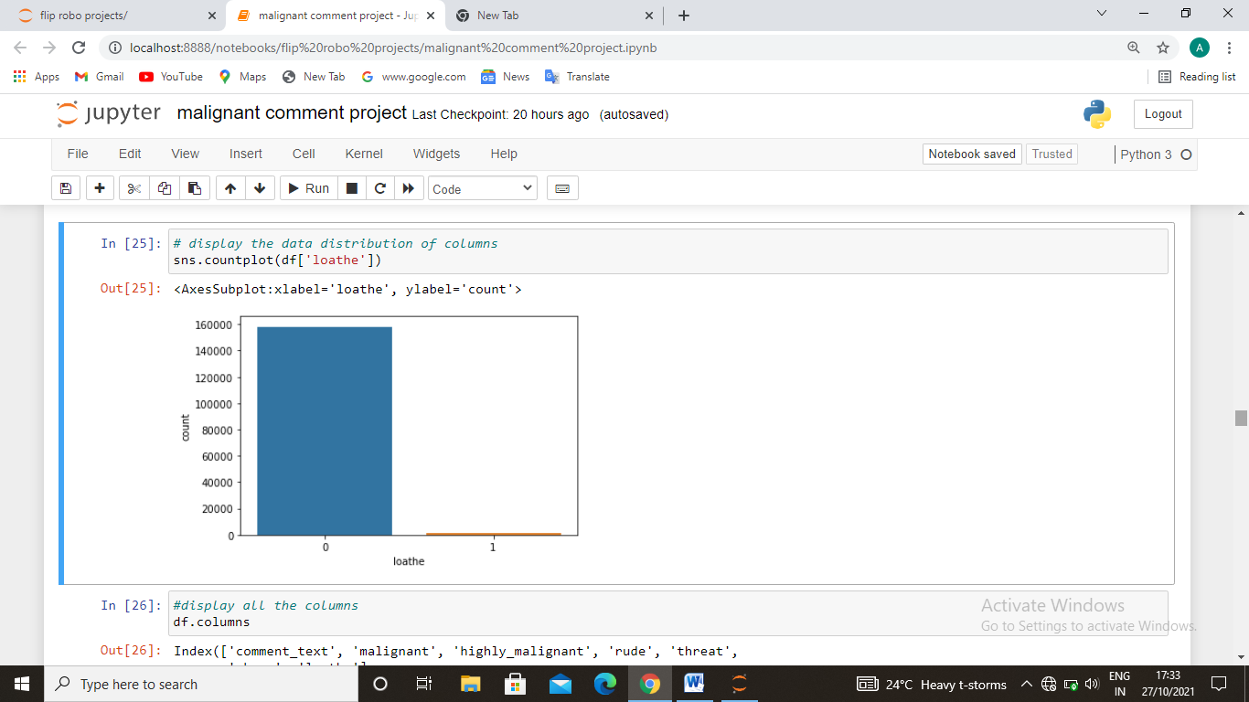
3. Checking the data distribution of abusive and loathe comment.
Observation - The number of threat comments are very low as compare to normal comments. Here the blue bar represents no and 1 represents yes that the comment is threat and rude or not.

Slide 11
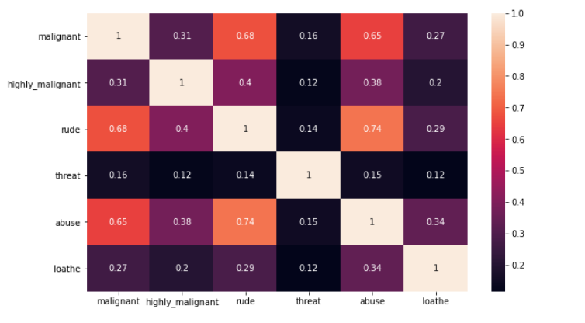
checking correlation of data with target variable.
observation - monthly recharge, 3month recharge and loans for both period are highly correlated with target variable

Slide 12
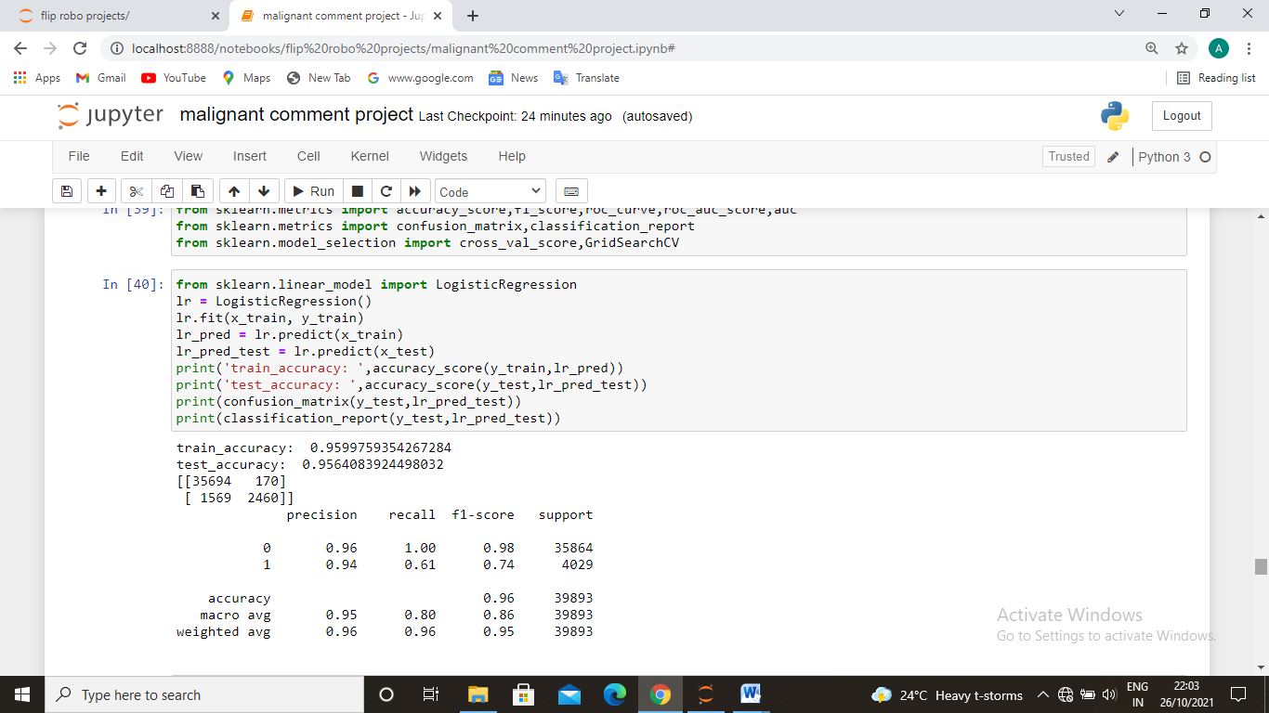
Model training
It was a regression problem that’s why we have used logistic regression. We have used decision tree regressor because it gives as the best accuracy score and its cross validation score was also good. And the difference between accuracy and cross validation score is very less. So we took this and also done the hyper parameter tuning to tune the data.

Slide 13
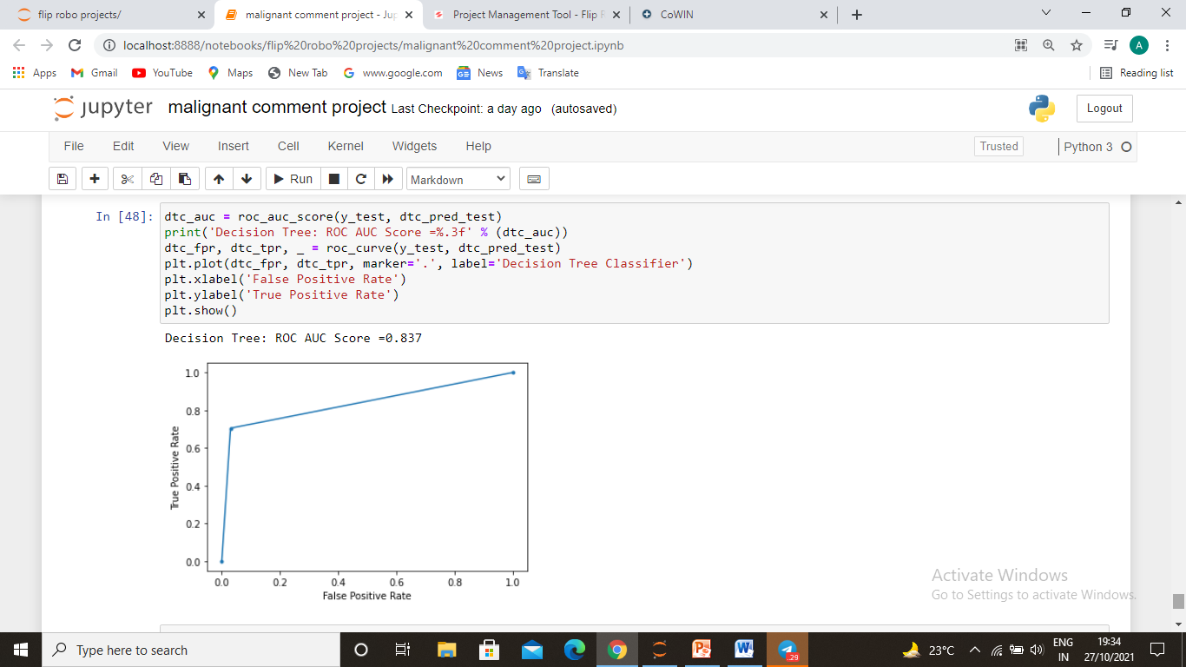
AUC ROC CURVE
we have chose the decision tree regressor because of its best fit accuracy score and cross validation score. So we do the hyper parameter tuning on this model.

Slide 14
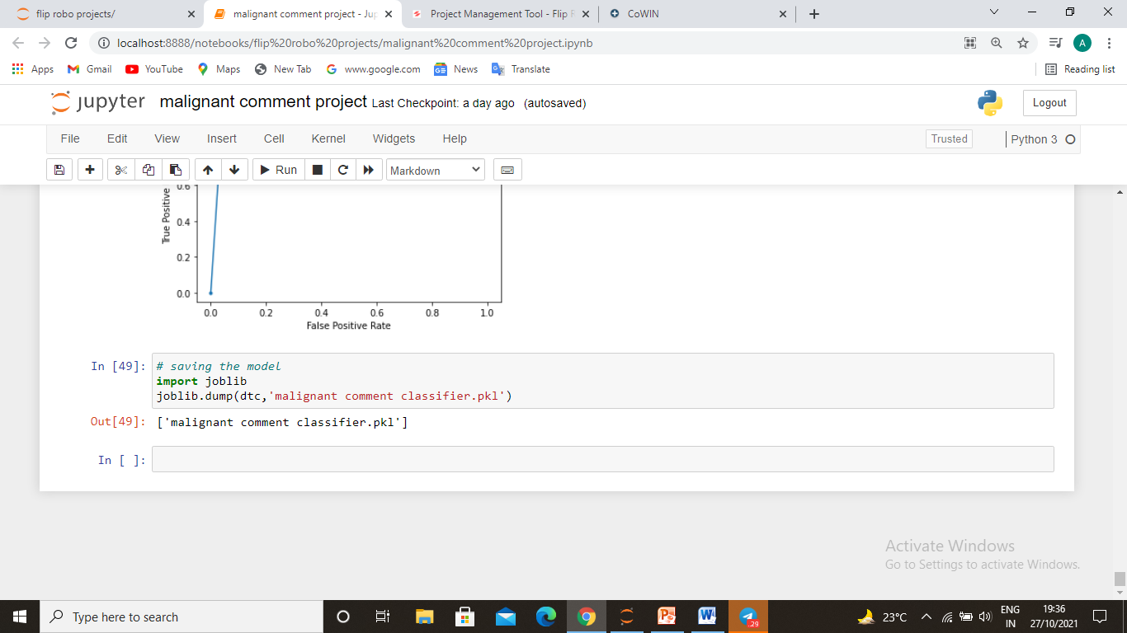
Saving the model
The conclusion is includes many factor as I mentioned earlier could effect the mental health of the celebrities or any individual. Malignant comments or threatfull comments and abusive comments on someone page is not right thing. And because of these the user didn’t focus on useful comments so we used the machine learning algorithm to make a project which classify the bad comments with the 98% accuracy in our model now if user wants to remove the bad comments he/she can filter it out and read only the good once.
Saving the model.

